Slide 1

AgentScore
Weekly update
Oct 29 - Nov 4, 2026
AgentScore Weekly Update
Week of November 9, 2026
Beta Cohorts and External Interest as of Nov 4, 2026.

Slide 2

AgentScore
Weekly update
Oct 29 - Nov 4, 2026
This week in four answers
Detail on the slides that follow
WHO IS USING IT
WHAT IS STOPPING ONBOARDING
FEEDBACK FROM PEOPLE USING IT
WHAT IS NEXT
1 customer live, 1 internal agent scoring
Most invites go unanswered
Users ask what comes after the score
Get every user to a first score
External
Tritusa is live and using the product.
Wolters Kluwer reported logged in, nothing run yet.
Internal
Tosca agent (ATA) is scoring.
Performance Agent, Quality Agent and the chatbot are in progress.
Lack of customers
94 emailed companies have not replied. Junk is 24 of 167 submissions (14%).
On-prem requirement
4 of 13 demos required it. Calls: Love's, Meta, Eaton, Accenture.
Suspected onboarding difficulty
Tritusa scored well and asked what comes next. Wolters Kluwer has not run anything.
Tritusa scored well
Ran its agents with proper traces. Now wants training on how scores are built and how to find failures.
Top asks across accounts
Simulation testing (6 accounts) and scoring a group of agents (5).
From Tritusa's email and the Customer Feedback Log.
Simpler onboarding
Make it incredibly simple and easy to get a first score.
Every internal agent
Onboard every internal Tricentis agent.
Spikes
JEV / decision models and stimulation testing.
Beta Cohorts and External Interest, Nov 4. Working sessions Oct 29, Nov 2, Nov 3. Customer Feedback Log. Roadmap Nov 4 (draft). Nov 6 status review. Nov 10 working session.

Slide 3
AgentScore
Weekly update
Oct 29 - Nov 4, 2026
Where each account stands
What each account is doing, and what blocks it. As of Nov 4
Tritusa Live. Use reported Nov 4. In the product by Oct 22. Agents scored well.
No next step after the score. Still open: compliance checks, alerting, and an export. Expected and actual run frequency: not measured.
Wolters Kluwer Reported signed in Nov 4. Nothing run. Beta Cohorts still has no sign-in date.
Group scoring. AI Workspace traces wait on a legal opt-in.
Accenture Pending beta.
On-prem, private AWS. Group scoring.
PG&E Demo held Oct 27. No follow-up.
Named on Nov 6 as wanting their own cloud. No email reply asked for on-prem.
Oracle Interested. No demo.
Named on Nov 6 as wanting their own cloud. No email reply asked for on-prem.
Eaton Invited Nov 2. No sign-in.
On-prem was not settled. A written data-handling answer. A CI/CD gate.
Meta Demo held. No follow-up.
On-prem in their own AWS. Simulation testing. Group scoring.
Love's Demo held Oct 2. No follow-up.
On-prem. They said they probably can't do much without it.
Aptiv Invited Oct 12. No sign-in.
Group scoring. No reply after follow-up.
No reply after follow-up Merito, L'Oréal, New Vision, BearingPoint, Workday
Invited, no sign-in. Merito also needs a partner-access answer.
Internal: Tosca agent (ATA) is scoring. Performance Agent, Quality Agent, the chatbot, and Smith are not.
Beta Cohorts Nov 4. Customer Feedback Log. Nov 6 status review.

Slide 4
AgentScore
Weekly update
Oct 29 - Nov 4, 2026
What is stopping onboarding
Three blockers, from the Nov 6 review and the trackers
LACK OF CUSTOMERS
ON-PREM REQUIREMENT
SUSPECTED ONBOARDING DIFFICULTY
No reply, not junk
4 of 13 demos required on-prem
Accounts get in, then stall on what to do next
94 emailed, no reply
28 of them never got a follow-up. Aug 20 waited 35 days for its only one. Nobody got a second.
Junk is 24 of 167
14%. 12 internal and 12 repeat or accidental. No consumer-mail signups. 3 more are unsure.
7 of 9 invited, no sign-in
Oct 12: Merito, L'Oréal, Aptiv, New Vision. Nov 2: Eaton, BearingPoint, Workday.
4 of 13 demos
They would not touch it without on-prem. No email reply asked for it. Calls named Love's, Meta, Eaton, and Accenture.
Asked up front
On-prem is now asked before a demo, so these leads stop at no demo.
5 have asked, as of Nov 10
A Nov 10 working session counted 5 companies, 3 of them this week. No decision to build it.
Tritusa unsure of next steps
Agents scored well, then they asked how scores work and how to find failures. Run frequency is not measured yet.
Wolters Kluwer: AI Workspace opt-in
Signed in but has not run anything. Scoring their AI Workspace traces, and L'Oréal's, waits on a legal opt-in.
Group scoring blocks 5
Wolters Kluwer, Meta, Aptiv, Eaton and Accenture. Eaton also waits on a CI/CD gate. Meta on simulation testing.
Nov 6 review. Lost Lead Analysis, Nov 10. Customer Feedback Log. Beta Cohorts, Nov 4.

Slide 5
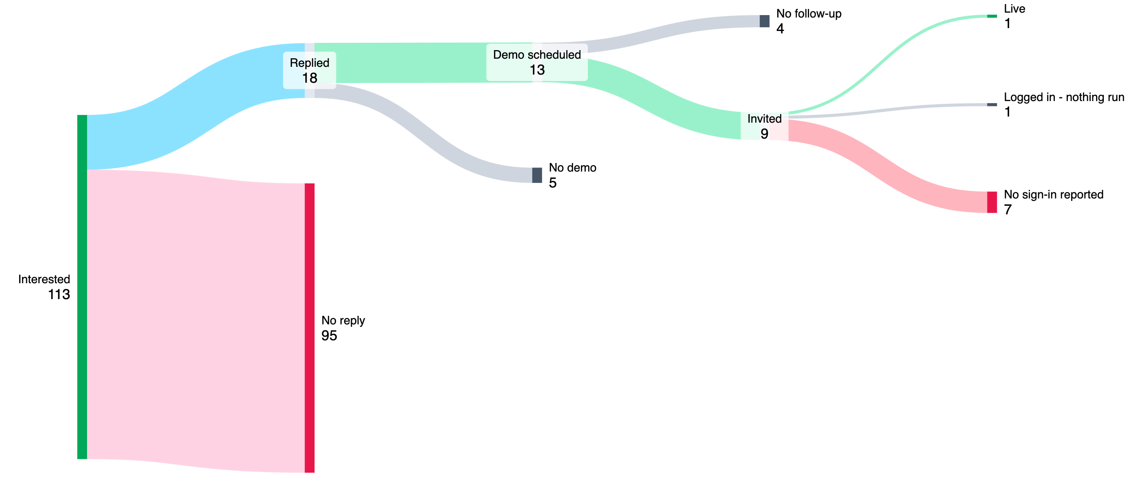
AgentScore
Weekly update
Oct 29 - Nov 4, 2026
7 of 9 invited: no sign-in reported
94 emailed, no reply. Follow-up was late. As of Nov 10
No follow-up
4
Live
1
Replied
18
Demo scheduled
13
Logged in - nothing run
1
Invited
9
No demo
5
No sign-in reported
7
Interested
113
No reply
95
Of the 9 invited: Tritusa live, Wolters Kluwer logged in, nothing run, 7 no sign-in. Junk is 24 of 167 (14%). 94 emailed companies have not replied. 28 got no follow-up.

Slide 6
AgentScore
Weekly update
Oct 29 - Nov 4, 2026
Signups: about 1 a day outside the three Transform events
Lack of signups. Labs form submissions per day (people, not companies), Aug 19 - Oct 30
Transform Dallas (Aug 20)
Transform London (Oct 22)
Transform Singapore (Sep 17)
140 dated Labs form submissions. 77 (55%) came on the three event days: 38 on Aug 20, 15 on Sep 17, 24 on Oct 22 (7 more on Oct 21).
The other 63 came over 70 days, 0.9 a day. Overall with event days is 1.9. Those invites are used up. Next is an early-adopter email through Ryan.
Dashed line: average outside event days, 0.9 a day

Slide 7
AgentScore
Weekly update
Oct 29 - Nov 4, 2026
Feedback from people using it
Tritusa ran its agents and they scored well. What they want now is help using the score.
TRITUSA, EMAIL TO ANDREW
TOP ASKS ACROSS ACCOUNTS
"We evaluated our AI agents today with proper traces, and they scored well in AgentScore."
Simulation testing and multi-agent scoring lead the list
They asked for a demo or training session on:
1. How AgentScore evaluates agents and calculates scores
2. Guardrails and configuration parameter setup
3. How to identify failures and improve scores
4. Best practices for agent evaluation
5. Report and recommendation generation
Simulation testing 6 accounts
Meta, L'Oréal, Tritusa, Eaton, PG&E, Accenture
Score a group of agents or a workflow 5 accounts
Meta, Wolters Kluwer, Aptiv, Eaton, Accenture
Access control and self-service onboarding 3 accounts
Wolters Kluwer, L'Oréal, Accenture
Export of traces and scores 3 accounts
Wolters Kluwer, Tritusa, Accenture
Cost and token report per agent 3 accounts
L'Oréal, Tritusa, Meta
CI/CD release gate 2 accounts
Eaton (headline requirement), Accenture
Jawahar Govindaraj. Teams are in Australia and India, so they asked for Mon-Thu slots at 8 AM or 8 PM EDT.
Tritusa email from Jawahar Govindaraj to Andrew. Customer Feedback Log, High-priority feature requests, by number of accounts.

Slide 8
AgentScore
Weekly update
Oct 29 - Nov 4, 2026
What is next
The three priorities from the draft roadmap (Nov 4), with this week's actions
SIMPLER ONBOARDING
EVERY INTERNAL AGENT
SPIKES
Get every user to a first score
Score every internal Tricentis agent
JEV / decision models and stimulation testing
Guided first session
Every screen offers one next action until the user reads a score and a verdict. No traces, profiles or evals to set up on the way.
Gaps still open
Home does not open the connect card, the first score does not start on its own, and verdict names differ by screen.
This week
Design the improved flow and identify gaps. Add Tritusa's Tuesday session on Wednesday.
Adoption, not product work
Connect and score each internal Tricentis agent. No new AgentScore feature is expected.
Where it stands
Only the Tosca agent (ATA) scores today. Owning teams need to set an agent-name attribute on their spans.
This week
Tim pushes the Performance Agent span-attribute PR. Product and Tim meet the agent owners and write a one-page instrumentation guide.
JEV / decision model
A hybrid scorer: the cheaper model where it fits the check, the full judge where it does not. Cuts scoring time and cost.
Stimulation testing
Profile the agent, run targeted tests, score the results and generate improvements, without waiting for real traces.
Why now
Simulation testing is the top ask (6 accounts).
Also this week: Andrew sends David the early-adopter email (smaller tech, telco, e-commerce). David takes it to Ryan. Product writes the AI Workspace legal brief and the charge map.
Lost-lead pass, Nov 10: junk is 24 of 167 (14%). 94 emailed companies have not replied. 28 got no follow-up. Also on Now: workflow grouping.

